Slide 1

William R. Leonard
APHP Director

Slide 2
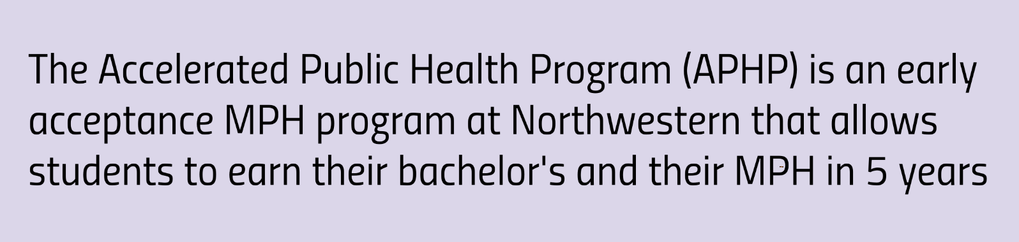
Program in Global Health Studies
Weinberg College of Arts & Science
and
Program in Public Health
Feinberg School of Medicine

Slide 3
The MPH Curriculum
16 Credits
Applied Practice Experience (APEx)
  Working/Engaging with a Public Health Organization
Culminating Experience (CE)
  Capstone Project:
  Research paper, Policy brief, Needs assessment

Slide 4
Degree Concentrations
Community Health Research & Evaluation
Data Science
Epidemiology
Generalist
Global Health
Maternal/Child Health
Implementation Science (new for 2026!)

Slide 5
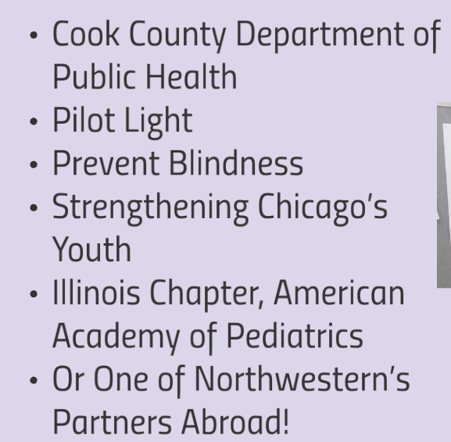

APEx Sites: Selected Examples
https://www.feinberg.northwestern.edu/sites/mph/community-partners/index.html

Slide 6
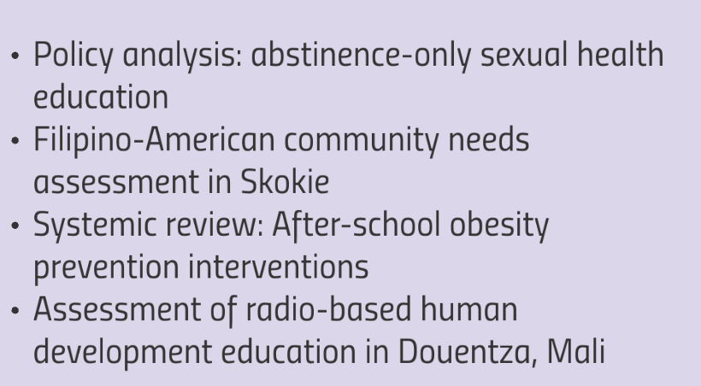
Culminating Experience: Examples

Slide 7
Distinctive Features of the APHP
Early acceptance into the NU MPH Program
Ability to complete the MPH degree in 1 year
Up to 3 300-level undergraduate GHS courses can count towards the MPH
May take up to 4 Public Health courses during senior year
Ability to reduce MPH tuition based on undergrad credits
Specialized advising
Ability to do an APEx Abroad (Generalist & Global Heath)

Slide 8
Eligibility Requirements & Prerequisites
Undergraduate at NU in any school or major
Apply during Junior Year
Target GPA: 3.5 & above
Prerequisites:
  1 Human Biology Class
  1 Math or Statistics Class

Slide 9
APHP Overview
Apply in your Junior year
Senior Year:
  May take up to 4 Public Health classes towards the MPH
  Individualized advising
MPH Year:
  Matriculate into the MPH Program after senior year
  Graduate with the MPH degree the following June

Slide 10
Application & Admissions Timeline
September 2026: Application portal opens
April 1, 2027: Application Deadline in CollegeNet
Late April, 2027: Applicant Interviews
May 1, 2027: Admission decisions announced
June 1, 2027: Admitted students submit decisions
June 2028: Matriculate into the MPH Program
June 2029: Graduate with the MPH degree

Slide 11
Application Process & Materials
Apply through CollegeNet by April 1, 2027
Application Materials:
  TGS Application form
  Personal Statement
  2 Letters of Recommendation
  Transcripts
  Resume/CV
Selected applicants invited for interviews in late April

Slide 12
Personal Statement
Length: 1-2 pages
Clearly describe your career goals related to Public Health
Should reflect an understanding of public health
Show some familiarity with the mission & strengths of NU’s MPH Program

Slide 13
Letters of Recommendation
Two letters are required
Should speak to the Candidate’s ability to succeed in a rigorous, fast-paced program
Highlight specific traits & strengths helpful for succeeding in the APHP

Slide 14
Interviews
In person 30-minute interviews with APHP faculty
Held on the Feinberg campus
Opportunity to discuss student’s goals and preparation
Opportunity to ask questions about the program.

Slide 15
Questions?
Thank you for your interest in the program!
Feel free to reach out to me:
  Bill Leonard: w-leonard1@northwestern.edu
Additional information available at:
  https://globalhealthstudies.northwestern.edu/academic-programs/aphp/
  https://www.feinberg.northwestern.edu/sites/mph/

